Slide 1

Lakshmi Narain College of Technology
Project title: Zomato Datasets Analysis
Major Project (CS-706)
HOD & Guide
Srashti Thakur
Submitted by:
Anup Moyal (0820CS223D07)
Govind Kumar(0820CS223D40)
Nishit Kumar(0820CS223D21)
Sourabh Kumar(0820S211081)
Tushar Khare(0820CS211087)
Department: CSE

Slide 2
Restaurant Recommender System

Slide 3
Content
Introduction
Problem Statements
Technology Used
Proposed Solutions & Key Findings
Conclusion

Slide 4

Introduction
This study explores the Zomato Indore Dataset to gain a comprehensive understanding of customer preferences, dining trends, and restaurant performance in Indore. By analyzing various data points, including customer ratings, cuisine popularity, pricing structures, and restaurant locations, this research provides data-driven insights tailored for key stakeholders such as restaurant owners, food delivery platforms, marketers, and city planners.

Slide 5
Problem Statement
Objective:
How can Zomato’s data provide insights into customer preferences, top-rated restaurants, and popular cuisines?
Specific Problems to Address:
Identifying high-demand cuisines and locations.
Analyzing factors that impact restaurant ratings.
Understanding price distribution across regions.

Slide 6
Technology Used
Data Processing & Analysis:
Python (libraries like pandas for data handling, NumPy for numerical operations)
Data Visualization:
Matplotlib and Seaborn for creating visual insights.
Additional Tools:
SQL for data manipulation
Frontend Tools (Reactjs CSS Material UI)
Environment:
Jupyter Notebook or other IDEs(Kaggle, Collab)used for analysis.

Slide 7
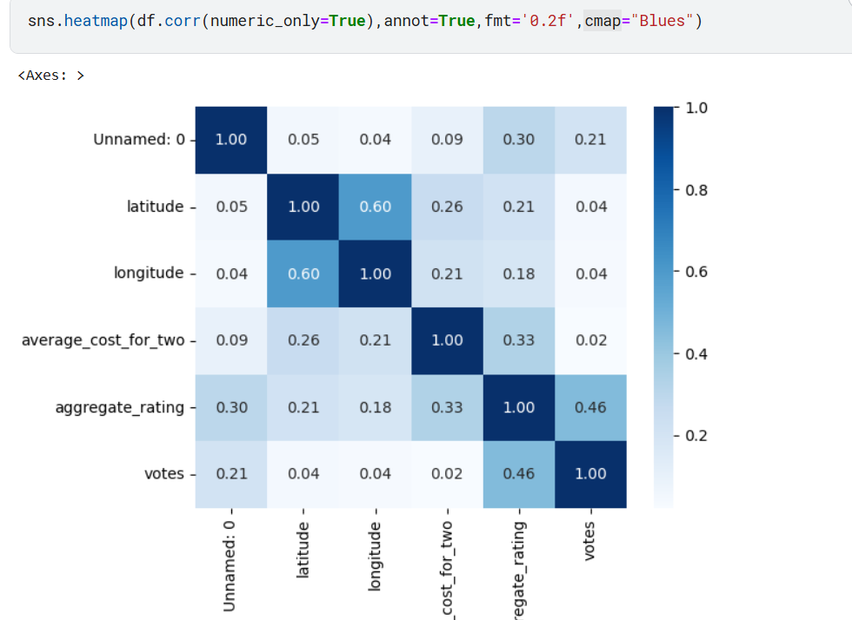
Selecting visual aids
Enhancing your presentation

Slide 8
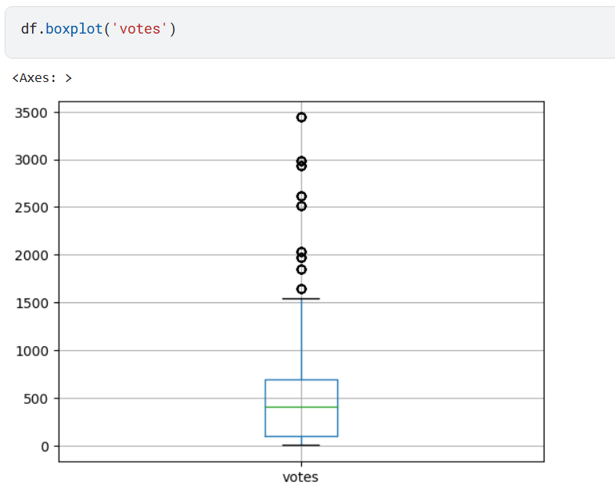

Slide 9
Proposed Solution & Key Findings
Solution Approach:
Data cleaning, preprocessing, and visual analysis to answer problem statements.
Grouping, aggregating, and visualizing data for trends.
Key Insights:
Most popular cuisines and areas, top-rated restaurants.
Pricing and rating trends based on region.
Key correlations (e.g., price vs. rating).
Visuals: Include a sample graph or chart illustrating one of the insights.

Slide 10

Conclusion & Future Work
The analysis of the Zomato Indore Dataset offers valuable insights into the restaurant landscape, customer preferences, and key market trends within the city. By examining customer ratings, pricing structures, restaurant distribution, and popular cuisines, this study highlights several crucial aspects of the dining experience in Indore, providing actionable recommendations for stakeholders across the food and beverage industry.
Future Work:
Ideas for enhancing the analysis, such as using machine learning to predict customer ratings or demand.

Slide 11
Thank you

